Slide 1


MODULE 2 :
INTRODUCTION TO GIT
PREPARED BY:
Dr. Nurulaqilla Khamis
Center for Artificial Intelligence and Robotics
Universiti Teknologi Malaysia

Slide 2
MODULE OUTLINE
01
03
What is Git?
Basic Git Terminology
02
Git Workflow and Fundamental Git Concepts
04
Basic Git Commands in CLI

Slide 3

01
WHAT IS GIT?

Slide 4
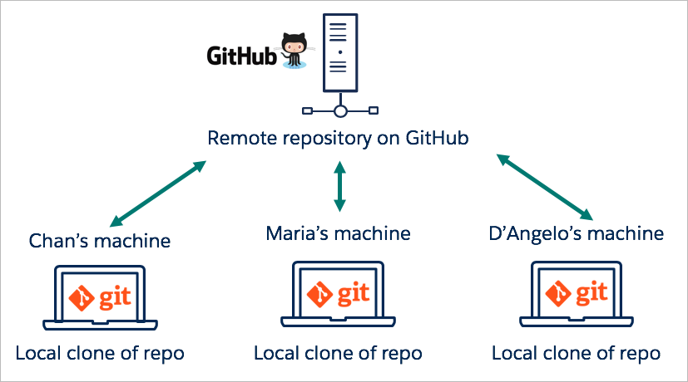
WHAT IS GIT?
Command used in Version Control System (VCS)
Set of commands that users can use to perform various version control tasks
Version control tasks : make copy of file, changes in file, file status, file history etc

Slide 5
02
GIT WORKFLOW & FUNDAMENTAL GIT CONCEPT

Slide 6



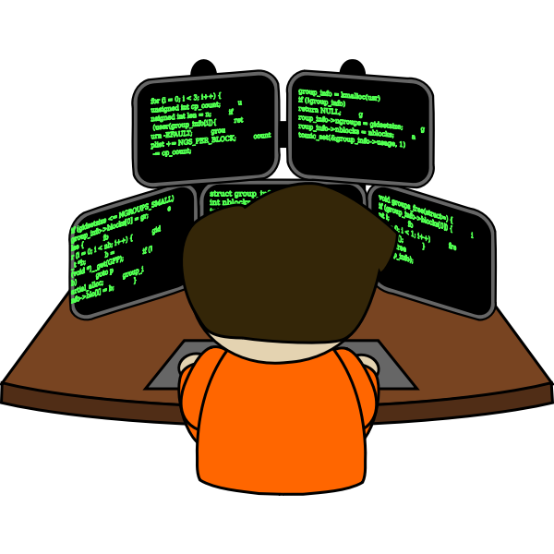
2
Folder/Repo: GitHubProject
README.MD
7
CLI :
git push
helloworld.c
6
CLI :
git commit –m “message”
Your Machine
1
Folder/Repo: GitHubProject
3
CLI :
git status
git add –A / git add . (All Files) @ git add [filename] (Single Files)
README.MD
5
helloworld.c
4
CLI :
git init
Programmer

Slide 7
03
BASIC GIT TERMINOLOGY

Slide 8
BASIC GIT TERMINOLOGY
Git Terminology | Descriptions
Repository | Storage with collection of files and directories
Init | Initialize new repository
Commit | Changes to repository at specific point in time
Add | Add file
Status | Information which files have been modified
Push | Upload local changes to remote repository

Slide 9
04
BASIC GIT COMMANDS IN CLI

Slide 10
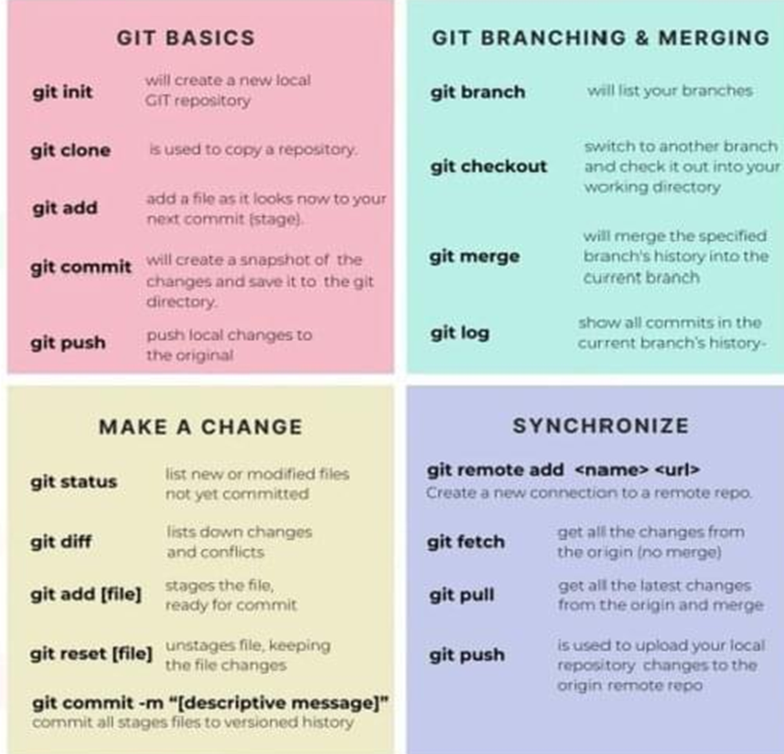
BASIC GIT COMMANDS IN CLI
Git commands are used by users to communicate with the machine
Git bash / command prompt is an application for Windows environments
Terminal is used for Mac user
There are numerous git commands to perform every functions

Slide 11
INSTALLATION & CONFIGURATION

Slide 12

INSTALL GIT ON YOUR LOCAL MACHINE
Install Git https://git-scm.com/downloads
Install Visual Studio Code (vscode)
    Open https://code.visualstudio.com/
    Click Download button

Slide 13
CONFIGURE GIT SETTINGS (NAME, EMAIL ADDRESS)
Configure Git (user information for all local repositories)
    git config --global user.name “name”
    git config --global user.email “email address”
    git config --global --list

Slide 14
cairo@utm.my / trainer’s email

